Slide 1
Nku companion app
Presented By: nick tope & eric spahr

Slide 2
Google maps api

Slide 3
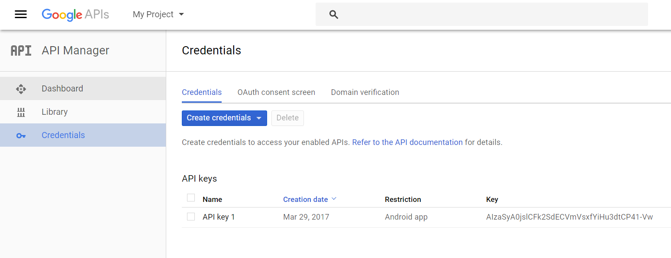

Slide 4


Slide 5
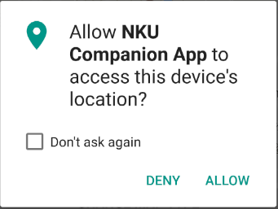


Slide 6
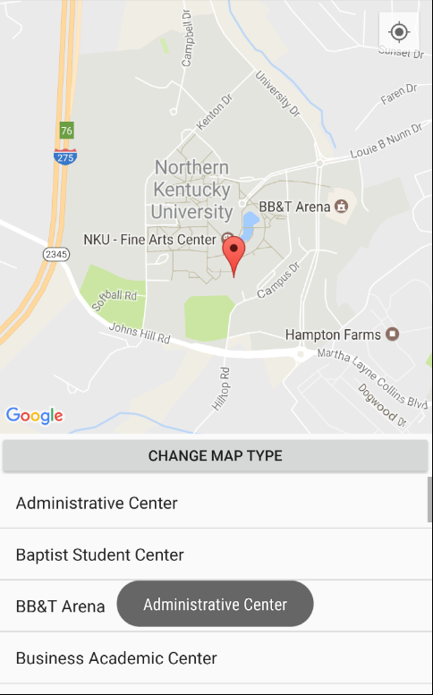

Slide 7


Slide 8
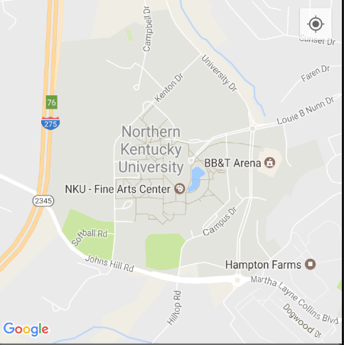
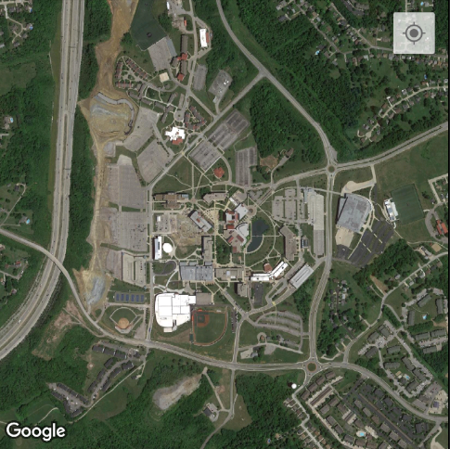


Slide 9
Myschedule activity

Slide 10


Slide 11
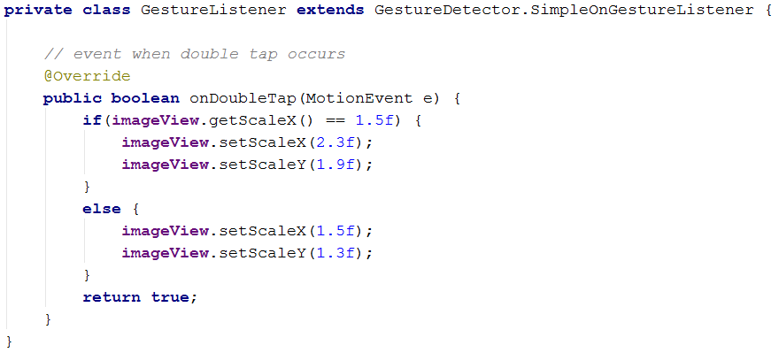

Slide 12
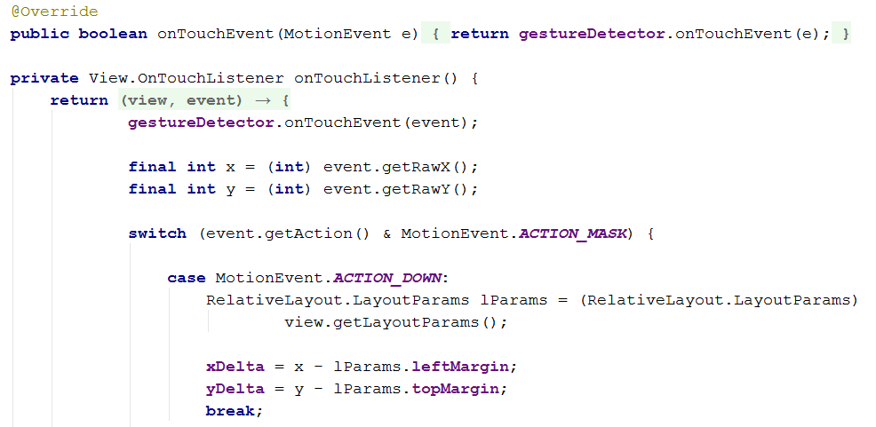

Slide 13
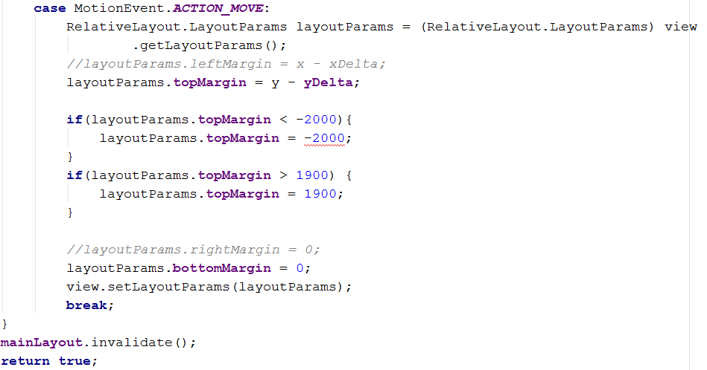

Slide 14
Main activity

Slide 15
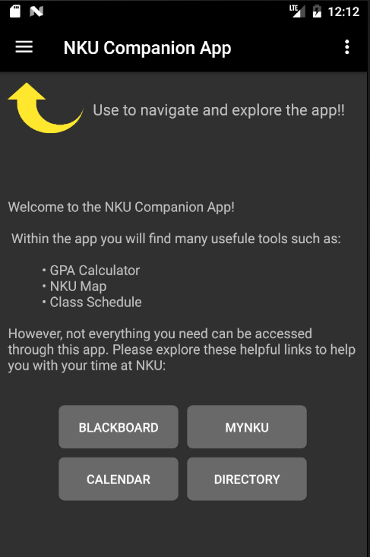

Slide 16


Slide 17
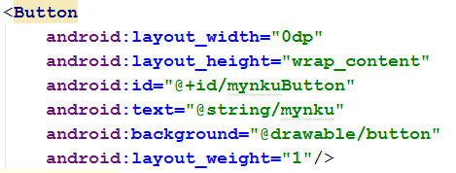



Slide 18
